Slide 1

CHAPTER 4 PUBLIC KEY CRYPTO
PREPARED BY:
DR. MUHAMMAD IQBAL HOSSAIN
ASSOCIATE PROFESSOR
DEPARTMENT OF CSE, BRAC UNIVERSITY
Notes:
‹#›

Slide 2
APPENDIX
DIFFIE-HELLMAN KEY EXCHANGE
ELLIPTIC CURVE CRYPTOGRAPHY
USES FOR PUBLIC KEY CRYPTO
INFORMATION HIDING
STEGANOGRAPHY
HASH FUNCTION

Slide 3
Diffie-Hellman Key exchange
CHAPTER 3 SYMMETRIC KEY CRYPTO. DR. MUHAMMAD IQBAL HOSSAIN
‹#›

Slide 4
DIFFIE-HELLMAN
Invented by Williamson (GCHQ) and, independently, by D and H (Stanford)
A “key exchange” algorithm
Used to establish a shared symmetric key
Not for encrypting or signing
Security rests on difficulty of discrete log problem: (Not known: NP-complete)
given g, p, and g^{k} mod p → find k
CHAPTER 3 SYMMETRIC KEY CRYPTO. DR. MUHAMMAD IQBAL HOSSAIN
‹#›
Notes:
DH is not for encrypting or signing, but instead it allows users to establish a shared symmetric key.
We have g, and g^k. what is k?
Find by LOG.
‹#›

Slide 5
DIFFIE-HELLMAN
Let p be prime, let g be a generator (p,g are public)
For any x ∈ {1,2,…,p-1} there is n s.t. x = g^{n} mod p
Alice selects secret value a
Bob selects secret value b
Alice sends gª mod p to Bob
Bob sends g^{b} mod p to Alice
Both compute shared secret g^{ab} mod p
(g^{b})ª = g^{ba} = g^{ab} mod p
Shared secret can be used as symmetric key
CHAPTER 3 SYMMETRIC KEY CRYPTO. DR. MUHAMMAD IQBAL HOSSAIN
‹#›
Notes:
Why share symm key?
‹#›

Slide 6
DIFFIE-HELLMAN
Suppose that Bob and Alice use g^{ab} mod p as a symmetric key
Trudy can see gª mod p and g^{b} mod p
Note gª g^{b} mod p = g^{a+b} mod p ≠ g^{ab} mod p
If Trudy can find a or b, system is broken
If Trudy can solve discrete log problem, then she can find a or b
CHAPTER 3 SYMMETRIC KEY CRYPTO. DR. MUHAMMAD IQBAL HOSSAIN
‹#›

Slide 7
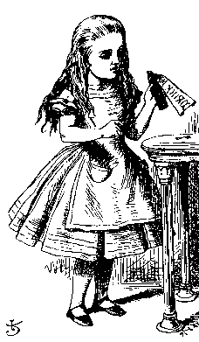
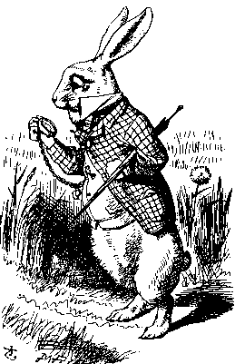
DIFFIE-HELLMAN
Public: g and p
Secret: Alice’s exponent a, Bob’s exponent b
gª mod p
g^{b} mod p
Alice, a
Bob, b
Alice computes (g^{b})ª = g^{ba} = g^{ab} mod p
Bob computes (gª)^{b} = g^{ab} mod p
Could use K = g^{ab} mod p as symmetric key
CHAPTER 3 SYMMETRIC KEY CRYPTO. DR. MUHAMMAD IQBAL HOSSAIN
‹#›

Slide 8
DIFFIE–HELLMAN KEY EXCHANGE
Alice
Bob
Choose random private key a ∈{1,2,…,p-1}
Choose random private key b ∈ {1,2,…,p-1}
Compute corresponding public key A = αª mod p
A
Compute correspondig public key B = α^{b} mod p
B
Compute common secret k_{AB} = Bª = (gª)^{b} mod p
Compute common secret k_{AB} = A^{b} = (g^{b})ª mod p
We can now use the joint key k_{AB} for encryption, e.g., with AES
y
y = AES_{kAB}(x)
x = AES⁻¹_{kAB}(y)
‹#›/19
Notes:
‹#›

Slide 9
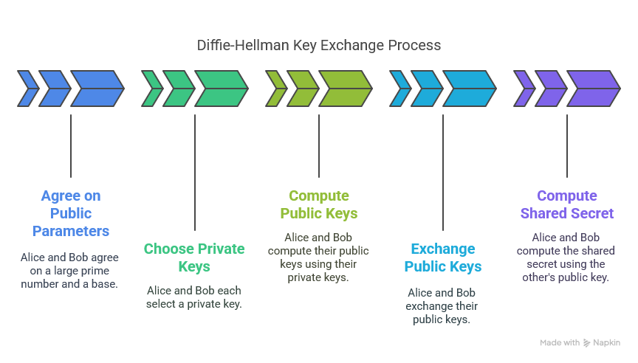

Slide 10
DIFFIE–HELLMAN KEY EXCHANGE: EXAMPLE
Domain parameters p=29, g=2
Alice
Bob
Choose random private key a = 5
Choose random private key b = 12
Compute corresponding public key A = gª = 2⁵ = 3 mod 29
A
Compute correspondig public key B = g^{b} = 2¹² = 7 mod 29
B
Compute common secret k_{AB} = Bª = g^{ba} = 7⁵ = 16 mod 29
Compute common secret k_{AB} = A^{b} = g^{ab} = 3¹² = 16 mod 29
Proof of correctness:
Alice computes: Bª = (g^{b})ª mod p Bob computes: A^{b} = (gª)^{b} mod p
i.e., Alice and Bob compute the same key k_{AB} !
‹#›/19
Notes:
‹#›

Slide 11
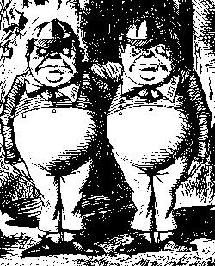
DIFFIE-HELLMAN
Subject to man-in-the-middle (MiM) attack
gª mod p
g^{t} mod p
g^{t} mod p
g^{b} mod p
Alice, a
Trudy, t
Bob, b
Trudy shares secret g^{at} mod p with Alice
Trudy shares secret g^{bt} mod p with Bob
Alice and Bob don’t know Trudy exists!
CHAPTER 3 SYMMETRIC KEY CRYPTO. DR. MUHAMMAD IQBAL HOSSAIN
‹#›

Slide 12
DIFFIE-HELLMAN
How to prevent MiM attack?
Solutions
Encrypt DH exchange with symmetric key
Encrypt DH exchange with public key
Sign DH values with private key
Other?
You MUST be aware of MiM attack on Diffie-Hellman
CHAPTER 3 SYMMETRIC KEY CRYPTO. DR. MUHAMMAD IQBAL HOSSAIN
‹#›

Slide 13
ECC: ELLIPTIC CURVE CRYPTOGRAPHY
Follow class lecture
CHAPTER 3 SYMMETRIC KEY CRYPTO. DR. MUHAMMAD IQBAL HOSSAIN
‹#›

Slide 14
ELLIPTIC CURVE CRYPTO (ECC)
“Elliptic curve” is not a cryptosystem
Elliptic curves are a different way to do the math in public key system
Elliptic curve versions of DH, RSA, etc.
Elliptic curves may be more efficient
Fewer bits needed for same security
But the operations are more complex
CHAPTER 3 SYMMETRIC KEY CRYPTO. DR. MUHAMMAD IQBAL HOSSAIN
‹#›

Slide 15
WHAT IS AN ELLIPTIC CURVE?
An elliptic curve E is the graph of an equation of the form
y² = x³ + ax + b
Also includes a “point at infinity” : ∞
What do elliptic curves look like?
See the next slide!
CHAPTER 3 SYMMETRIC KEY CRYPTO. DR. MUHAMMAD IQBAL HOSSAIN
‹#›

Slide 16

ELLIPTIC CURVE PICTURE
y
Consider elliptic curve
E: y² = x³ - x + 1
If P₁ and P₂ are on E, we can define
P₃ = P₁ + P₂
as shown in picture
Addition is all we need
For discrete points, we add “mod p” to the EC
P₂
P₁
x
P₃
CHAPTER 3 SYMMETRIC KEY CRYPTO. DR. MUHAMMAD IQBAL HOSSAIN
‹#›

Slide 17
KEY SIZE COMPARISON
Symmetric | ECC | RSA, DL | Remark
64 Bit | 128 Bit | ≈ 700 Bit | Only short term security (a few hours or days)
80 Bit | 160 Bit | ≈ 1024 Bit | Medium security (except attacks from big governmental institutions etc.)
128 Bit | 256 Bit | ≈ 3072 Bit | Long term security (without quantum computers)
CHAPTER 3 SYMMETRIC KEY CRYPTO. DR. MUHAMMAD IQBAL HOSSAIN
‹#›

Slide 19
Content of this Chapter
Linear feedback shift registers (LFSRs)
Follow class lecture

Slide 20
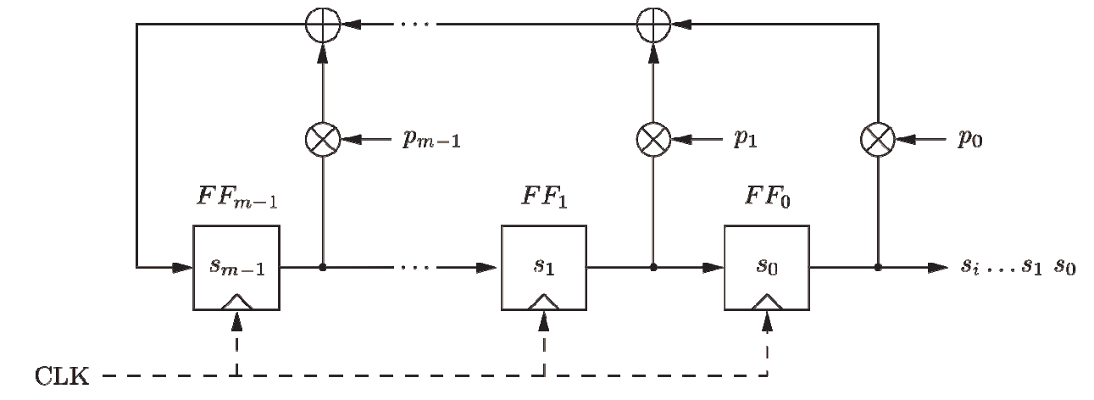
Linear Feedback Shift Registers (LFSRs)
Concatenated flip-flops (FF), i.e., a shift register together with a feedback path
Feedback computes fresh input by XOR of certain state bits
Degree m given by number of storage elements
If p_{i} = 1, the feedback connection is present (“closed switch), otherwise there is not feedback from this flip-flop (“open switch”)
Output sequence repeats periodically
Maximum output length: 2^{m}-1

Slide 21
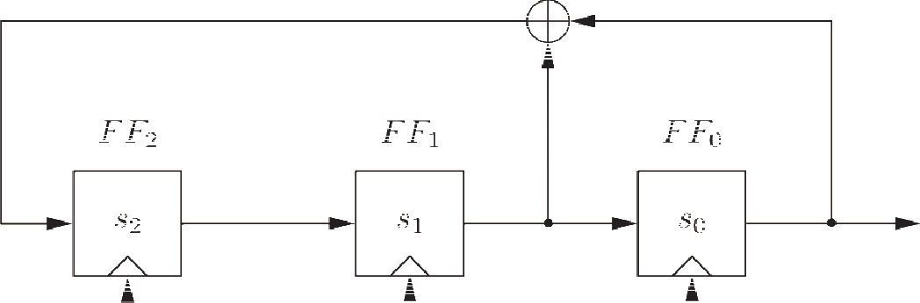
Linear Feedback Shift Registers (LFSRs): Example with m = 3
clk | FF₂ | FF₁ | FF₀=s_{i}
0 | 1 | 0 | 0
1 | 0 | 1 | 0
2 | 1 | 0 | 1
3 | 1 | 1 | 0
4 | 1 | 1 | 1
5 | 0 | 1 | 1
6 | 0 | 0 | 1
7 | 1 | 0 | 0
8 | 0 | 1 | 0
LFSR output described by recursive equation:
s_{i+3} = s_{i+1} + s_{i} mod 2
Maximum output length (of 2³-1=7) achieved only for certain feedback configurations, .e.g., the one shown here.

Slide 22
Security of LFSRs
LFSRs typically described by polynomials:
P(x) = x^{m} + p x^{m−1} + ... + p x + p
l −1 1 0
Single LFSRs generate highly predictable output
If 2m output bits of an LFSR of degree m are known, the feedback coefficients p_{i} of the LFSR can be found by solving a system of linear equations*
Because of this many stream ciphers use combinations of LFSRs
*See Chapter 2 of Understanding Cryptography for further details.

Slide 23
USES FOR PUBLIC KEY CRYPTO
CHAPTER 3 SYMMETRIC KEY CRYPTO. DR. MUHAMMAD IQBAL HOSSAIN
‹#›

Slide 24
USES FOR PUBLIC KEY CRYPTO
Confidentiality
Transmitting data over insecure channel
Secure storage on insecure media
Authentication (later)
Digital signature provides integrity and non-repudiation
No non-repudiation with symmetric keys
Who has the secret key is the key for non-repudiation.
CHAPTER 3 SYMMETRIC KEY CRYPTO. DR. MUHAMMAD IQBAL HOSSAIN
‹#›
Notes:
non-repudiation..cant say didn’t do this
‹#›

Slide 25
NON-NON-REPUDIATION
Alice orders 100 shares of stock from Bob
Alice computes MAC using symmetric key
Stock drops, Alice claims she did not order
Can Bob prove that Alice placed the order?
No! Since Bob also knows symmetric key, he could have forged message
Problem: Bob knows Alice placed the order, but he can’t prove it
CHAPTER 3 SYMMETRIC KEY CRYPTO. DR. MUHAMMAD IQBAL HOSSAIN
‹#›
Notes:
Alice and bob share symmetric key because MAC is used
‹#›

Slide 26
NON-REPUDIATION
Alice orders 100 shares of stock from Bob
Alice signs order with her private key
Stock drops, Alice claims she did not order
Can Bob prove that Alice placed the order?
Yes! Only someone with Alice’s private key could have signed the order
This assumes Alice’s private key is not stolen (revocation problem)
CHAPTER 3 SYMMETRIC KEY CRYPTO. DR. MUHAMMAD IQBAL HOSSAIN
‹#›
Notes:
Only alice can sign so it can be proved
‹#›

Slide 27
PUBLIC KEY NOTATION
Sign message M with Alice’s private key: [M]_{Alice}
Encrypt message M with Alice’s public key: {M}_{Alice}
Then
{[M]_{Alice}}_{Alice} = M
[{M}_{Alice}]_{Alice} = M
Part 1 ⎯ Cryptography ‹#›

Slide 28
CONFIDENTIALITY AND NON-REPUDIATION?
Suppose that we want confidentiality and integrity/non-repudiation
Can public key crypto achieve both?
Alice sends message to Bob
Sign and encrypt: {[M]_{Alice}}_{Bob}
Encrypt and sign: [{M}_{Bob}]_{Alice}
Can the order possibly matter?
Part 1 ⎯ Cryptography ‹#›

Slide 29

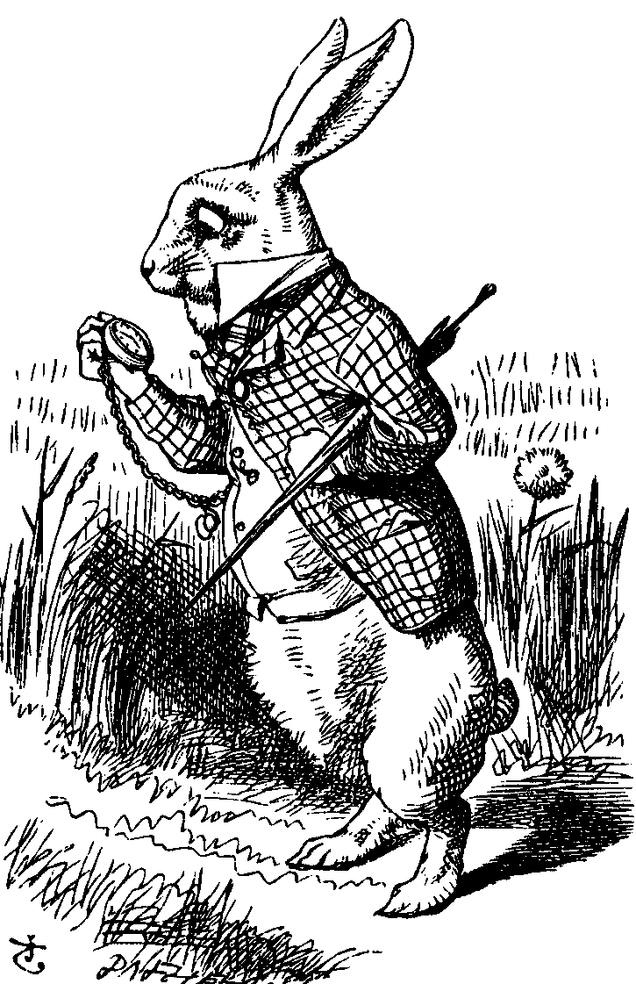
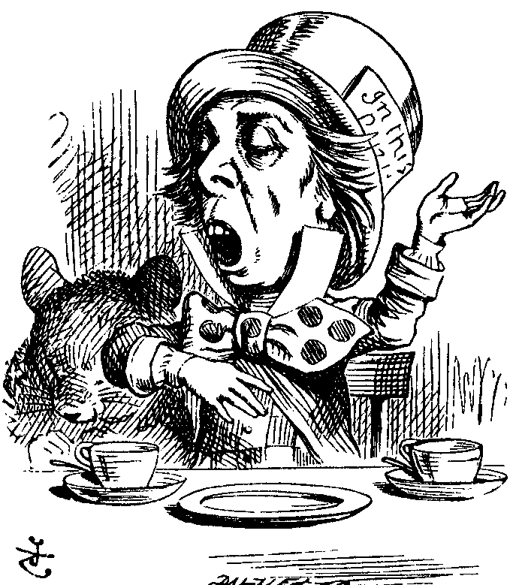
SIGN AND ENCRYPT
M = “I love you”
{[M]_{Alice}}_{Bob}
{[M]_{Alice}}_{Charlie}
Alice
Bob
Charlie
Q: What’s the problem?
A: No problem ⎯ public key is public
Part 1 ⎯ Cryptography ‹#›

Slide 30
ENCRYPT AND SIGN
M = “My theory, which is mine….”
[{M}_{Bob}]_{Alice}
[{M}_{Bob}]_{Charlie}
Alice
Charlie
Bob
Note that Charlie cannot decrypt M
Q: What is the problem?
A: No problem ⎯ public key is public
Part 1 ⎯ Cryptography ‹#›

Slide 31
PUBLIC KEY CERTIFICATE
Digital certificate contains name of user and user’s public key (possibly other info too)
It is signed by the issuer, a Certificate Authority (CA), such as VeriSign
M = (Alice, Alice’s public key), S = [M]_{CA}
Alice’s Certificate = (M, S)
Signature on certificate is verified using CA’s public key
Must verify that M = {S}_{CA}
Part 1 ⎯ Cryptography ‹#›

Slide 32
CERTIFICATE AUTHORITY
Certificate authority (CA) is a trusted 3rd party (TTP) ⎯ creates and signs certificates
Verify signature to verify integrity & identity of owner of corresponding private key
Does not verify the identity of the sender of certificate ⎯ certificates are public!
Big problem if CA makes a mistake
CA once issued Microsoft cert. to someone else
A common format for certificates is X.509
Part 1 ⎯ Cryptography ‹#›

Slide 33
INFORMATION HIDING

Slide 34
INFORMATION HIDING DIGITAL WATERMARK
Digital Watermarks
The “Digital Watermarking” name from watermarking of paper or money as a security measure
A technique which allows an individual to add hidden copyright notices to digital audio, video, or image signals and documents
Defense against music or software piracy
Example: Add “invisible” identifier to data
Digital watermarking can be a form of steganography
‹#›
CHAPTER 5 OTHER TOPICS

Slide 35
INFORMATION HIDING DIGITAL WATERMARK
Add a “mark” to data
Several types of watermarks
Type 1
Invisible ⎯ Not obvious the mark exists
Visible ⎯ Such as TOP SECRET stamp
Type 2
Robust ⎯ Readable even if attacked
Fragile ⎯ Mark destroyed if attacked
‹#›
CHAPTER 5 OTHER TOPICS

Slide 36
INFORMATION HIDING DIGITAL WATERMARK
Add robust invisible mark to digital music
If pirated music appears on Internet, can trace it back to original source
Add fragile invisible mark to audio file
If watermark is unreadable, recipient knows that audio has been tampered (integrity)
Combinations of several types are sometimes used
E.g., visible plus robust invisible watermarks
‹#›
CHAPTER 5 OTHER TOPICS

Slide 37
INFORMATION HIDING STEGANOGRAPHY
Steganography − “Hidden writing”
The art and science of writing hidden messages
recipient does not know of the existence of the mssg
Hide the fact that information is being transmitted − a kind of covert channel (Ch8)
Secret communication channel
Cryptography, where the existence of the message itself is not disguised, but the content is obscured.
Example: Hide data in image or music file
‹#›
CHAPTER 5 OTHER TOPICS

Slide 38
INFORMATION HIDING STEGANOGRAPHY
According to Herodotus (Greece 440BC)
Shaved slave’s head
Wrote message on head
Let hair grow back
Send slave to deliver message
Shave slave’s head to expose message (warning of Persian invasion)
Historically, Steganography has been used more than cryptography!
‹#›
CHAPTER 5 OTHER TOPICS

Slide 39
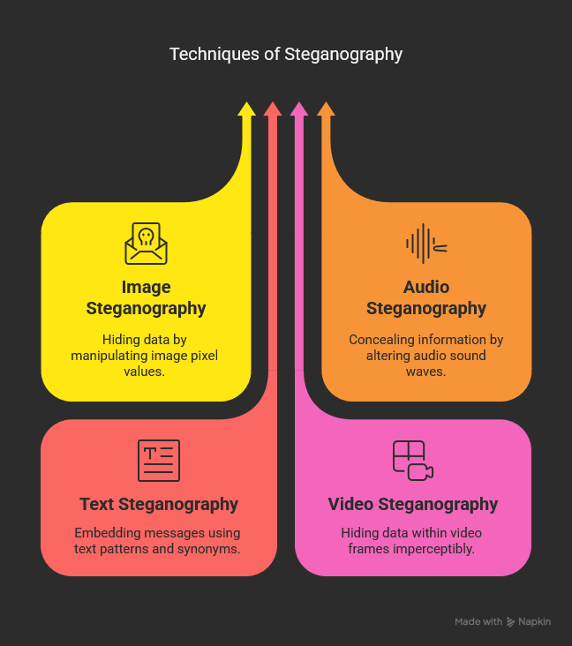
Techniques of Steganography

Slide 40
INFORMATION HIDING STEG EXAMPLE
Images use 24 bits for color: RGB
8 bits for red, 8 for green, 8 for blue
For example
0x7E 0x52 0x90 is this color
0xFE 0x52 0x90 is this color
While
0xAB 0x33 0xF0 is this color
0xAB 0x33 0xF1 is this color
Low-order bits are unimportant!
‹#›
CHAPTER 5 OTHER TOPICS

Slide 41
INFORMATION HIDING STEG EXAMPLE
Given an uncompressed image file
For example, BMP format
Then we can insert any information into low-order RGB bits
Since low-order RGB bits don’t matter, result will be “invisible” to human eye
But a computer program can “see” the bits
‹#›
CHAPTER 5 OTHER TOPICS

Slide 42
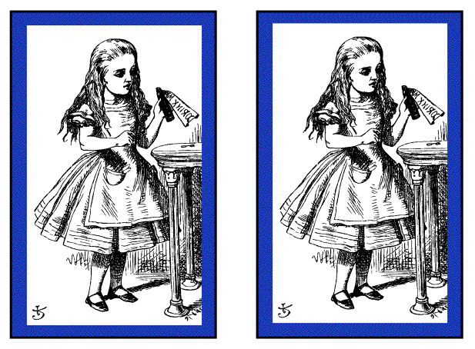
INFORMATION HIDING STEG EXAMPLE 1
Left side: plain Alice image
Right side: Alice with entire Alice in Wonderland (pdf) “hidden” in image
‹#›
CHAPTER 5 OTHER TOPICS

Slide 43
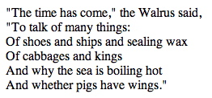

INFORMATION HIDING STEG EXAMPLE 2
Non-Steganography Example
Walrus.html in web browser
View source
‹#›
CHAPTER 5 OTHER TOPICS

Slide 44
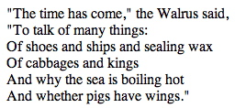

INFORMATION HIDING STEG EXAMPLE 2
stegoWalrus.html in web browser
View source
“Hidden” message: 110 010 110 011 000 101
‹#›
CHAPTER 5 OTHER TOPICS

Slide 45
INFORMATION HIDING STEGANOGRAPHY
Some formats (jpg, gif, wav, etc.) are more difficult (than html) for humans to read
Easy to hide information in unimportant bits
Easy to destroy or remove info stored in unimportant bits!
‹#›
CHAPTER 5 OTHER TOPICS

Slide 46
INFORMATION HIDING STEGANOGRAPHY
To be robust, information must be stored in important bits
But stored information must not damage data!
Collusion attacks also a major concern
The original and watermarked object can be compared
Robust steganography is trickier than it seems
‹#›
CHAPTER 5 OTHER TOPICS

Slide 47
THE BOTTOM LINE OF INF HIDING
If information hiding is suspected
Attacker can probably make information/watermark unreadable
Attacker may be able to read the information, given the original document (image, audio, etc.)
‹#›
CHAPTER 5 OTHER TOPICS

Slide 48

CHAPTER 5 HASH FUNCTIONS Not required for exam
PREPARED BY:
DR. MUHAMMAD IQBAL HOSSAIN
ASSOCIATE PROFESSOR
DEPARTMENT OF CSE, BRAC UNIVERSITY

Slide 49
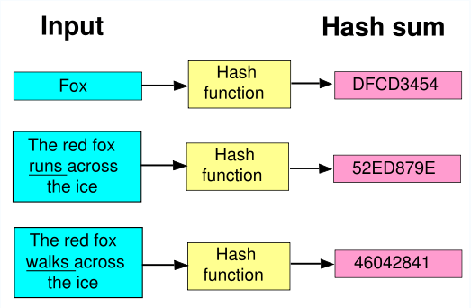
HASH FUNCTION?
Hash function
a reproducible method of turning some kind of data into a (relatively) small number that may serve as a digital "fingerprint" of the data.
Crypto Hash function
a hash function with certain additional security properties to make it suitable for use as various info security applications
CHAPTER 5 HASH FUNCTION
‹#›

Slide 50
HASH FUNCTION MOTIVATION
Suppose Alice signs M
Alice sends M and S = [M]_{Alice} to Bob
Bob verifies that M = {S}_{Alice}
Aside: Is it OK to just send S?
If M is big, [M]_{Alice} is costly to compute
Suppose instead, Alice signs h(M), where h(M) is much smaller than M
Alice sends M and S = [h(M)]_{Alice} to Bob
Bob verifies that h(M) = {S}_{Alice}
CHAPTER 5 HASH FUNCTION
‹#›
Notes:
‹#›

Slide 51
CRYPTO HASH FUNCTION
Crypto hash function h(x) must provide the following properties
Compression
output length is small
Efficiency
h(x) easy to computer for any x
One-way
given a value y it is infeasible to find an x such that h(x) = y
CHAPTER 5 HASH FUNCTION
‹#›
Notes:
Compression — For any size input x, the output length of y = h(x) is small. In practice, the output is a fixed size (e.g., 160 bits), regardless of the length of the input.
• Efficiency — It must be easy to compute h(x) for any input x. The computational effort required to compute h{x) will, of course, grow with the length of x, but it cannot grow too fast.
• One-way — Given any value y, it's computationally infeasible to find a value a; such that h{x) = y. Another way to say this is that there is no feasible way to invert the hash.
‹#›

Slide 52
CRYPTO HASH FUNCTION
Weak collision resistance
given x and h(x), infeasible to find y with y ≠ x such that h(y) = h(x)
Strong collision resistance
infeasible to find any x and y, with x ≠ y such that h(x) = h(y)
Lots of collisions exist, but hard to find one
CHAPTER 5 HASH FUNCTION
‹#›
Notes:
• Weak collision resistance — Given x and h(x), it's infeasible to find any y, with y ö x, such that h(y) = h(x). Another way to state this requirement is that it is not feasible to modify a message without changing its hash value.
• Strong collision resistance — It's infeasible to find any x and y, such that x ö y and h(x) = h(y). That is, we cannot find any two inputs that hash to the same output.
Alice has a cryptographic hash function h. Then h(M) can be viewed as a "fingerprint" of the file M, that is, h(M) is much smaller than M but it identifies M. If M' differs from M, even by just a single bit, then the hashes will almost certainly differ.1 Furthermore, the collision resistance properties imply that it is not feasible to replace M with any different message M' such that h(M) = h(M’).
‹#›

Slide 53
POPULAR CRYPTO HASHES
MD(Message Digest) 5
invented by Rivest
128 bit output
MD2 → MD4 → MD5
MD2 and MD4 are no longer secure, due to collision found
Note: even MD5, collision recently found
CHAPTER 5 HASH FUNCTION
‹#›

Slide 54
POPULAR CRYPTO HASHES
SHA(Secure Hash Algorithm)-1
A US government standard (similar to MD5)
“The world’s most popular hash function”
180 bit output
SHA-0 → SHA-1
Many others hashes, but MD5 and SHA-1 most widely used
CHAPTER 5 HASH FUNCTION
‹#›

Slide 55
Hash usages
CHAPTER 5 HASH FUNCTION
‹#›

Slide 56
HASH USES
Authentication (HMAC)
Message integrity (HMAC)
Message fingerprint
Data corruption detection
Digital signature efficiency
Anything you can do with symmetric crypto ???
CHAPTER 5 HASH FUNCTION
‹#›

Slide 57
ONLINE AUCTION
Suppose Alice, Bob and Charlie are bidders
Alice plans to bid A, Bob B and Charlie C
They don’t trust that bids will stay secret
Solution?
Alice, Bob, Charlie submit hashes h(A), h(B), h(C)
All hashes received and posted online
Then bids A, B and C revealed
Hashes don’t reveal bids (one way)
Can’t change bid after hash sent (collision)
CHAPTER 5 HASH FUNCTION
‹#›

Slide 58
HASH FUNCTION
SHA -Secure Hash Algorithm
MD5 – Message Digest
The process
Sender use MD5
Append Message Digest to plain text
Send it to receiver
Receiver compute with MD5
Receiver compare MD5, MD5
CHAPTER 5 HASH FUNCTION
‹#›

Slide 59
MD5 ALGORITHM (128 BIT)
The Message is padded to an exact multiple of 512 bit blocks.
Append 64 bit representation
Initiate the MD buffers (32-bit, 4 buffer, A, B, C, D)
Process the each block (512)
Output (message digest in buffers)
CHAPTER 5 HASH FUNCTION
‹#›

Slide 60
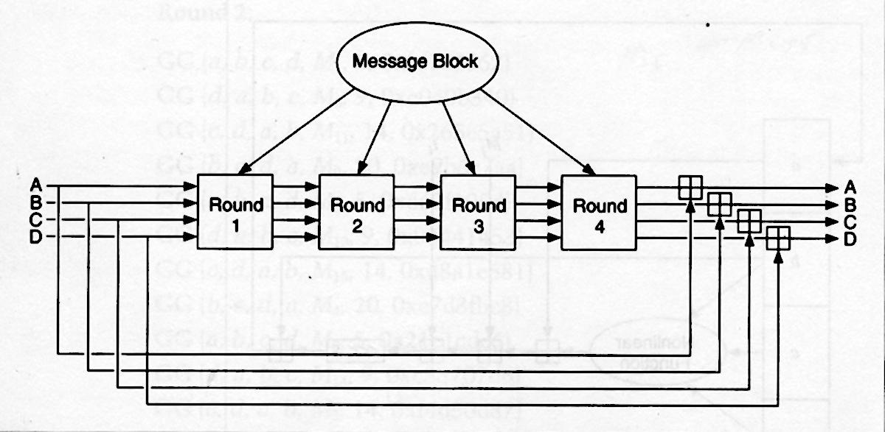
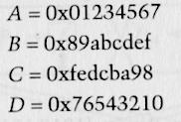
MAIN MD5 LOOP
IVs
CHAPTER 5 HASH FUNCTION
‹#›

Slide 61
Initializing Vector
Plain text, X
32
512
D
A
B
C
F, T[1-16], X[ ]
A
B
C
D
Each round have 16 constraints and 16 steps.
Each constraint will use in each step.
G, T[17-34], X[ ]
A
B
C
D
H, T[35-48], X[ ]
Uses 4 32-bit inputs: a, b, c, d
Also uses a 32-bit sub-block of the message block
Generates 4 32-bit outputs for the next round step or the next round
A
B
C
D
I, T[49-64], X[ ]
+
CHAPTER 5 HASH FUNCTION
‹#›
MD
Notes:
addition modulo = (A + B) mod C = (A mod C + B mod C) mod C
‹#›

Slide 62
DIFFICULTY IN CRACKING
Md5, with its 128bit encryption algorithm has 1,280,000,000,000,000,000 possible combinations.
Even if the exact same hash value found, possible other string combination could have created it.
It is considered that the md5 message digest would take an unrealistic time to crack via brute force attack.
CHAPTER 5 HASH FUNCTION
‹#›

Slide 63
PROS/CONS MD5
Easy to use
Widely used
Considered secure
Difficult to crack
Is susceptible to brute force attacks
Hash collisions is a known flaw
Quantum computers would make such an algorithm worthless
CHAPTER 5 HASH FUNCTION
‹#›

